Slide 1
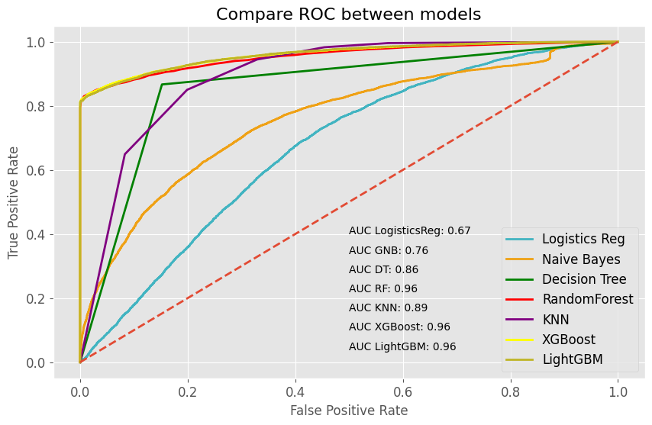
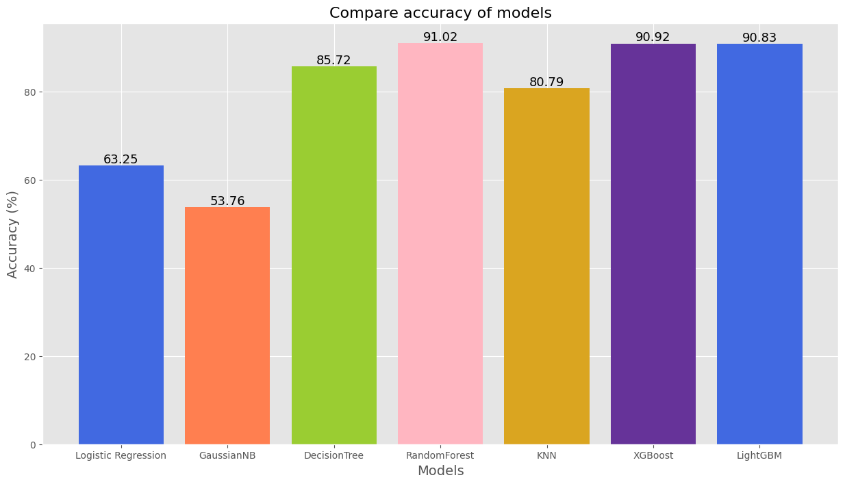
Evaluate Model
After training the models, I get the RandomForest, XGBoost and LightGBM models that give the best results.
Accuracy of models reaches more than 90%. AUC are all equal and equal to 0.96.

Slide 2
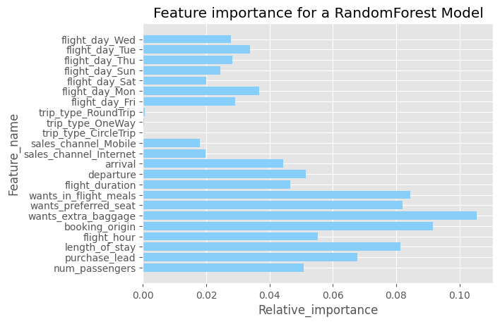
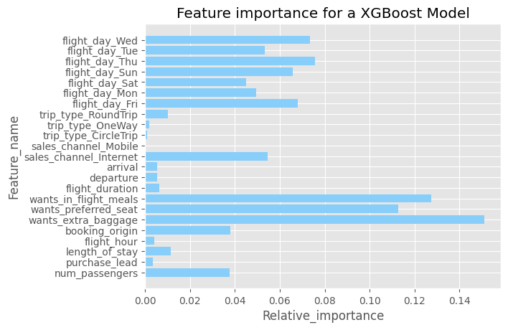
Contribution of Features
In both models, ‘wants_extra_baggage’ is the most importance feature.
Features like ‘want_preferred_seat’, ‘wants_in_flight_meals’, ‘booking_origin’ are also contributed to the model.

